Slide 1


Film Recommendation Software: Creating a Film Recommendation Chatbot using GODEL
This presentation shares my journey in developing a film recommendation chatbot using AI and explores lessons learned and potential improvements.
by Tamara K.

Slide 2
Background: Importance of Film Recommendation Systems
Overwhelmed Viewers
Personalized Experience
With the ever-growing volume of films and streaming services, viewers often find themselves overwhelmed by choices.
Recommendation systems tailor suggestions based on user preferences, leading to a more enjoyable viewing experience.

Slide 3



My Approach:
Take-Away
Even though the chatbot did not work out as expected I have been able to gather programming experience and formulate what I would do different in similar projects in the future.
1
Data Gathering
2
Integrated the AI model and a database into my project. Fine-tuning it, to get it to work. Bug-fixing and more research on why it did not work as expected.
Research
3
I researched papers on this topic to learn what the current state of the art in this area is as well as chose an AI model on Hugging-face that seemed to fit my criteria.

Slide 4
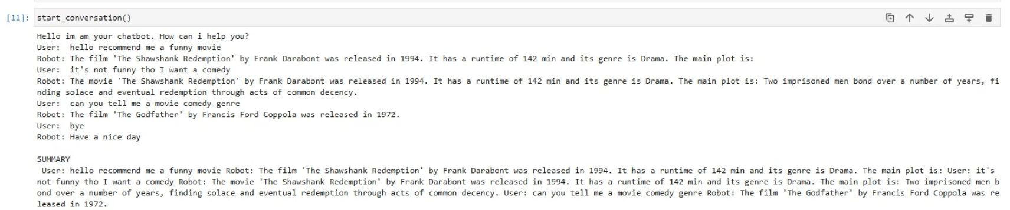
Challenges Faced:

Slide 5
Trying to find solutions:
variations in data input
fine-tuning the model
trying out new phrasings for the user-input
asking ChatGPT
asking on Reddit
—> realizing that the model might not be a good fit for my project-plans

Slide 6
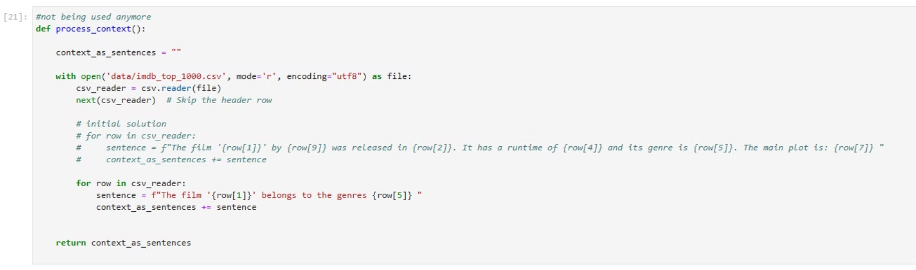

Slide 7
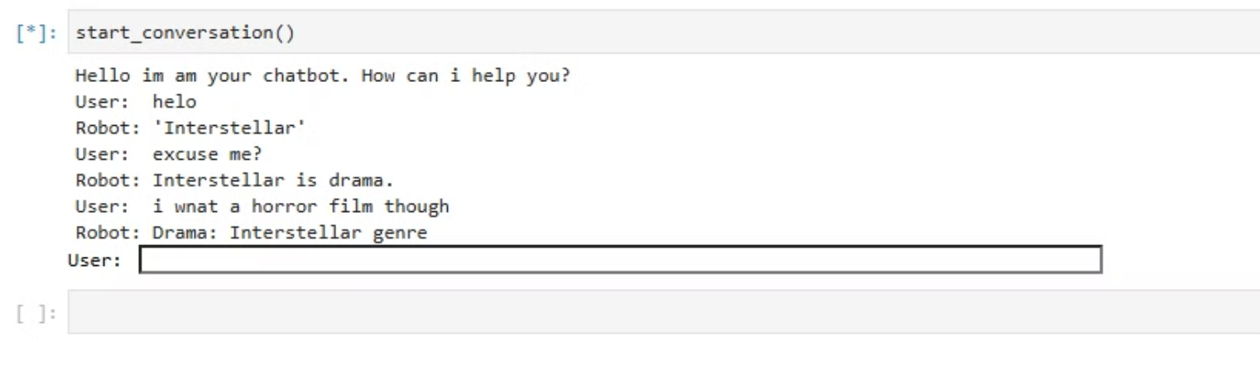
After researching more and trying a different approach to the data-input:

Slide 8

Lessons Learned: Key Takeaways from the Failed Experiment
1
Model
2
Data
It's important to find a model that fits its purposes even though this is sometimes hard to judge based on just code and maybe a paper.
Figuring out a way of data input that works best can be tricky.
3
Trouble shooting
—> found various useful ways of bug-fixing

Slide 9




Potential Improvements: What I Would Do Differently Next Time
Different model
First and foremost I think it mainly failed due to a difference in my expectations and the way my chosen model works. I would chose a different one if I was to do it again.
Improve my programming skills beforehand
Not having done any programming for a semester after finishing the beginner's course two semesters ago did not make this project easier.
Trying different approaches
Playing around with a few different models at first before really starting to put in the work. This would have made establishing if the model works - beforehand - easier, than realizing that this is not going to work out far too late into the process.

Slide 10

Conclusion: Future Opportunities and Reflections on the Learning Process
This project has highlighted the importance of chosing the right model, data input and flexibility in working with differenc approaches.

